Slide 1


Operating System Security (CYS337)
WIRELESS HACKING
BY JAMES SOKO (20231392)

Slide 2
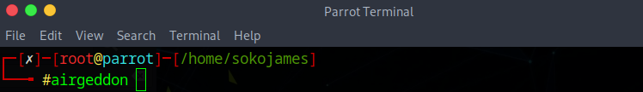
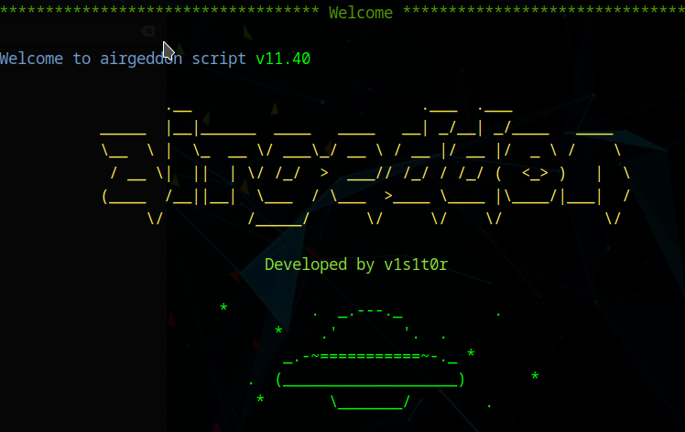
Airgeddon
Open your Linux terminal as root (sudo su) and type airgeddon if its already installed, if not sudo apt-get install airgeddon

Slide 3
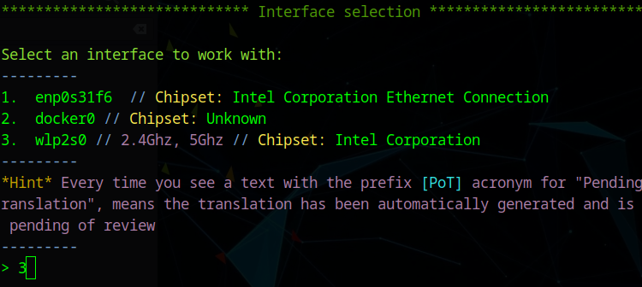
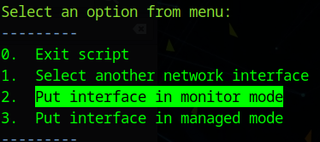
Monitor Mode
Select the Wireless Interface and change the mode from Managed Mode to Monitor Mode.

Slide 4
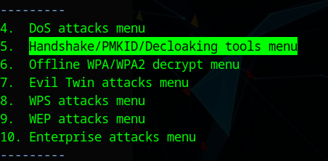
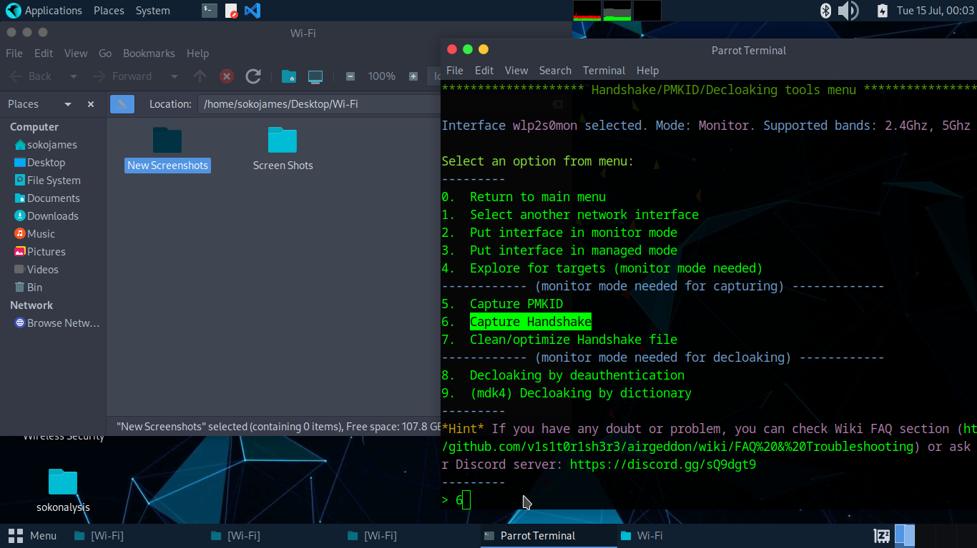
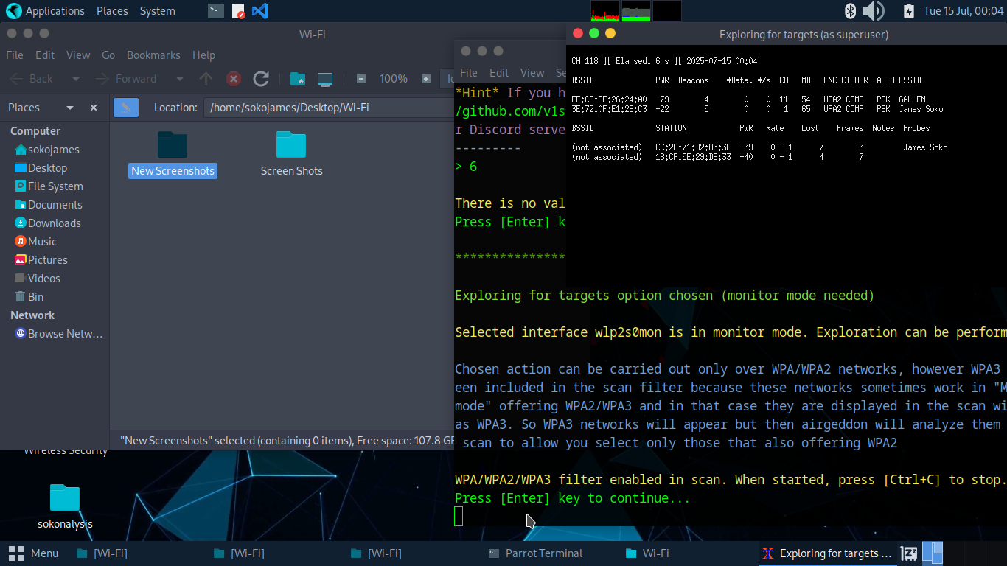
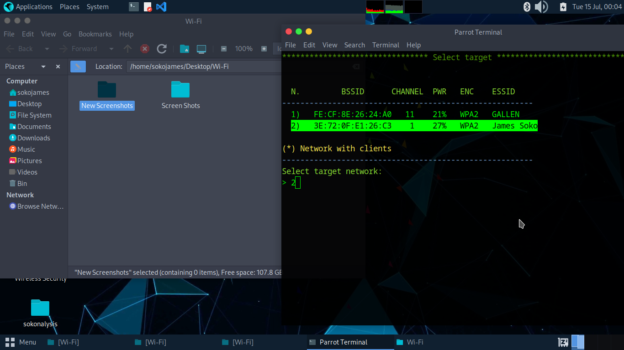
Handshake
Establish a Handshake.

Slide 5
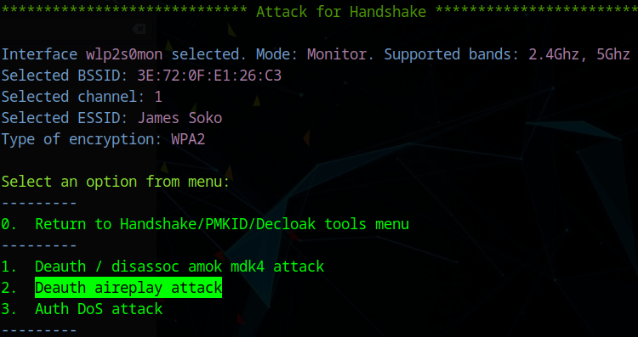
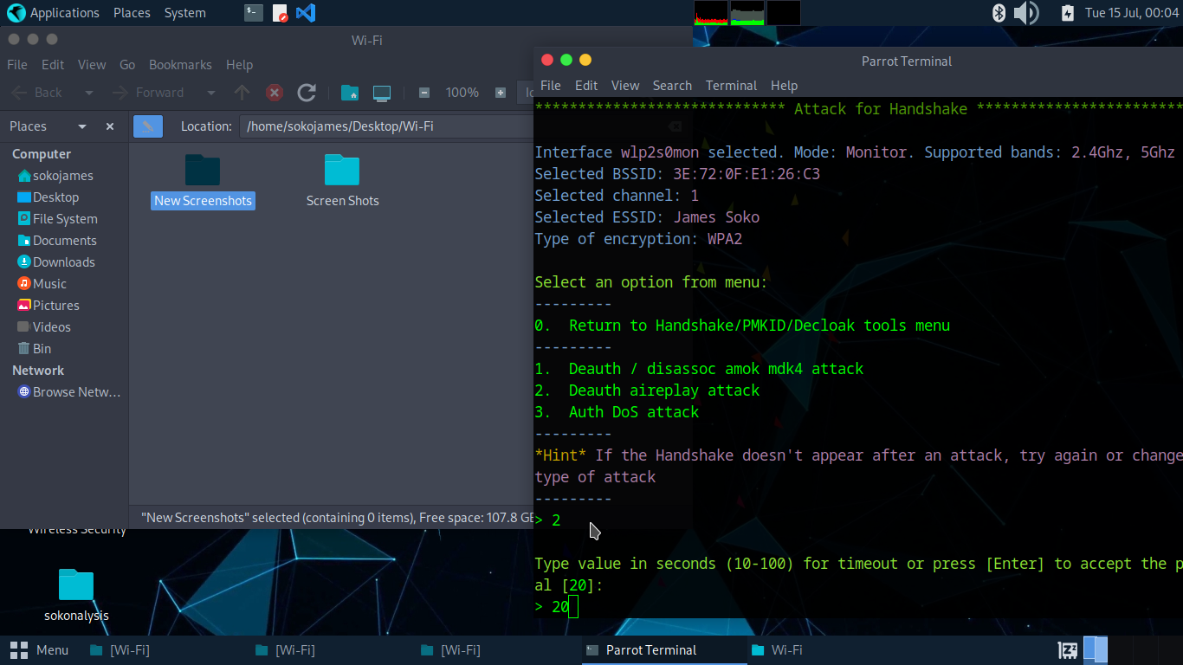
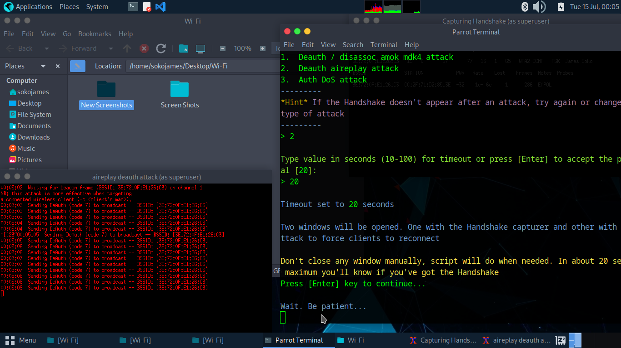
De-authentication
NOTE: Someone must be connected to the target Wireless Network (i.e., James Soko) for the de-authentication to be a success.

Slide 6
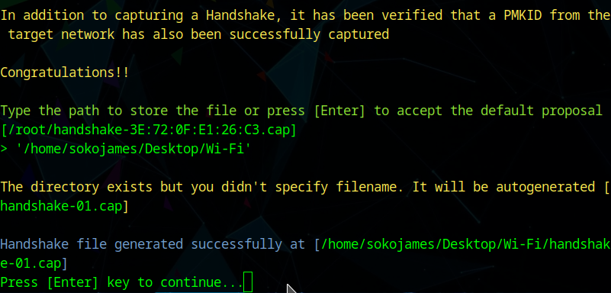
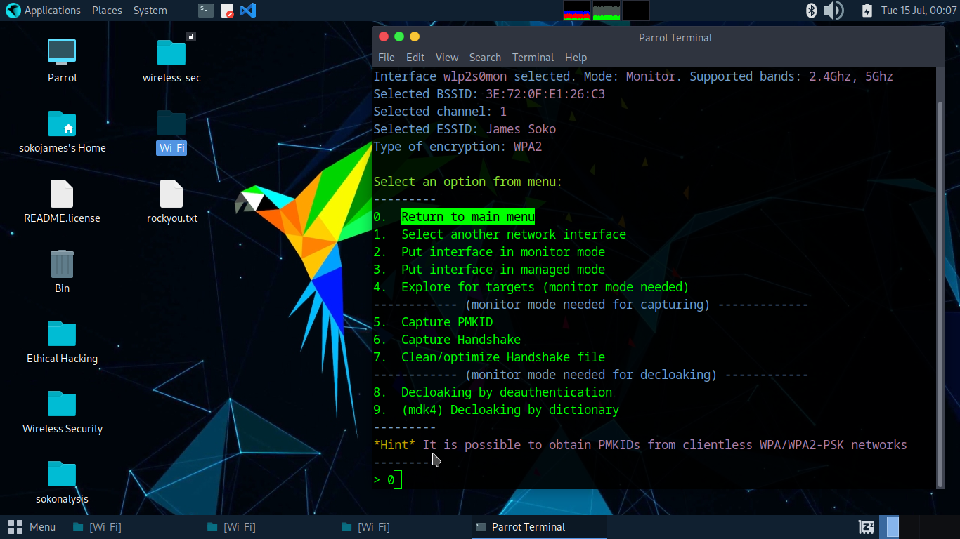
Successful Handshake
Make sure that the handshake and the de-authentication are a success.

Slide 7
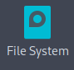
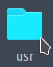
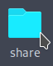
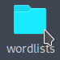
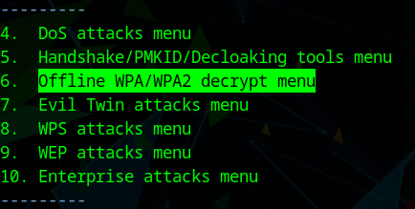
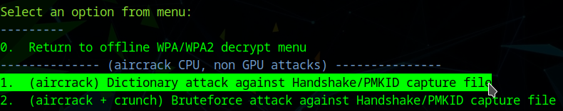
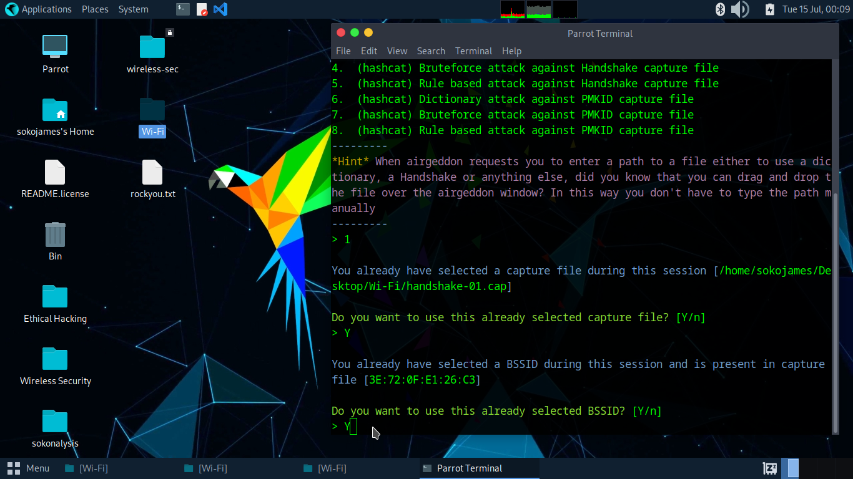
Offline Password Decryption
NOTE: We are using a wordlist to launch this attack and you can utilize them in the:

Slide 8
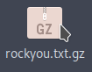
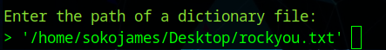
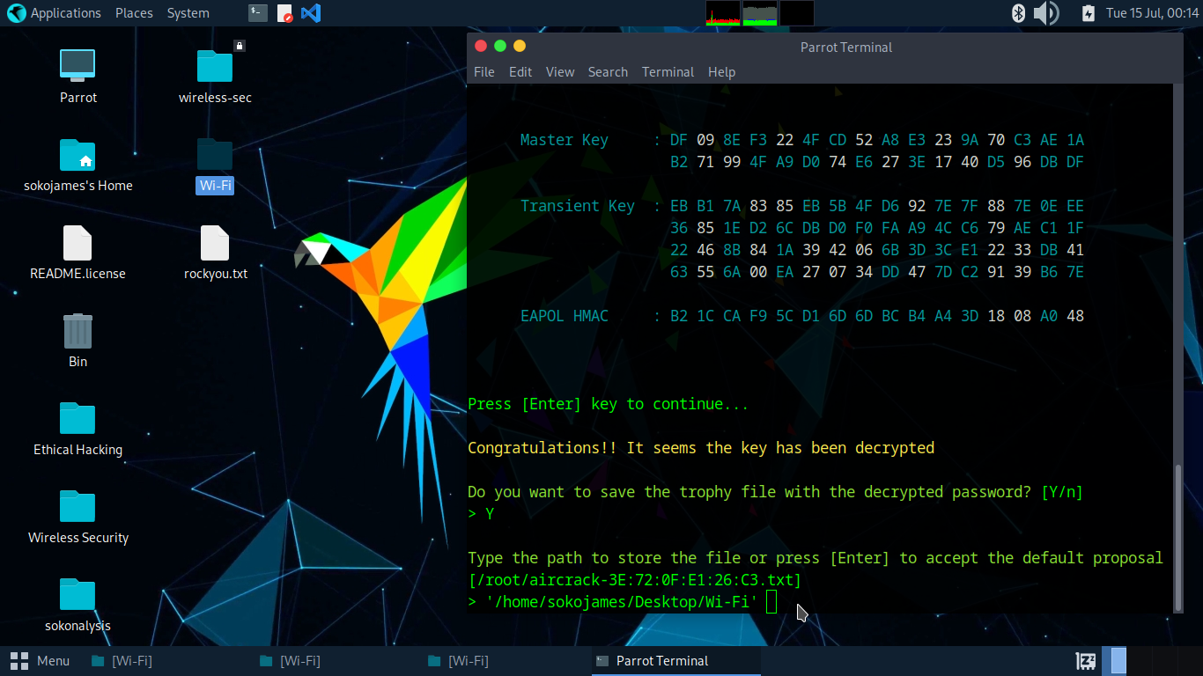
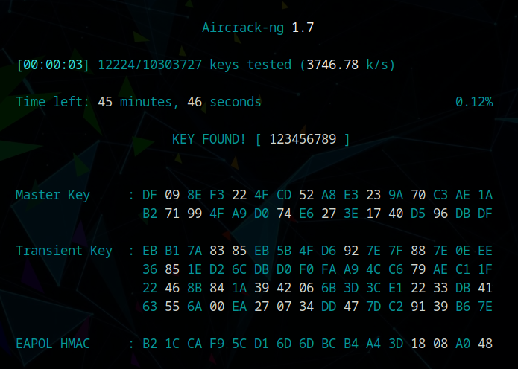
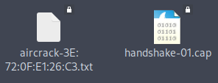
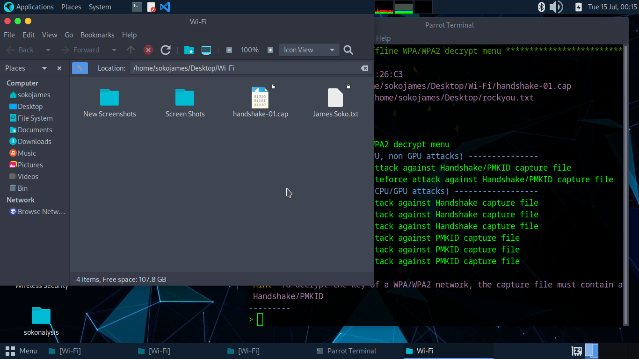
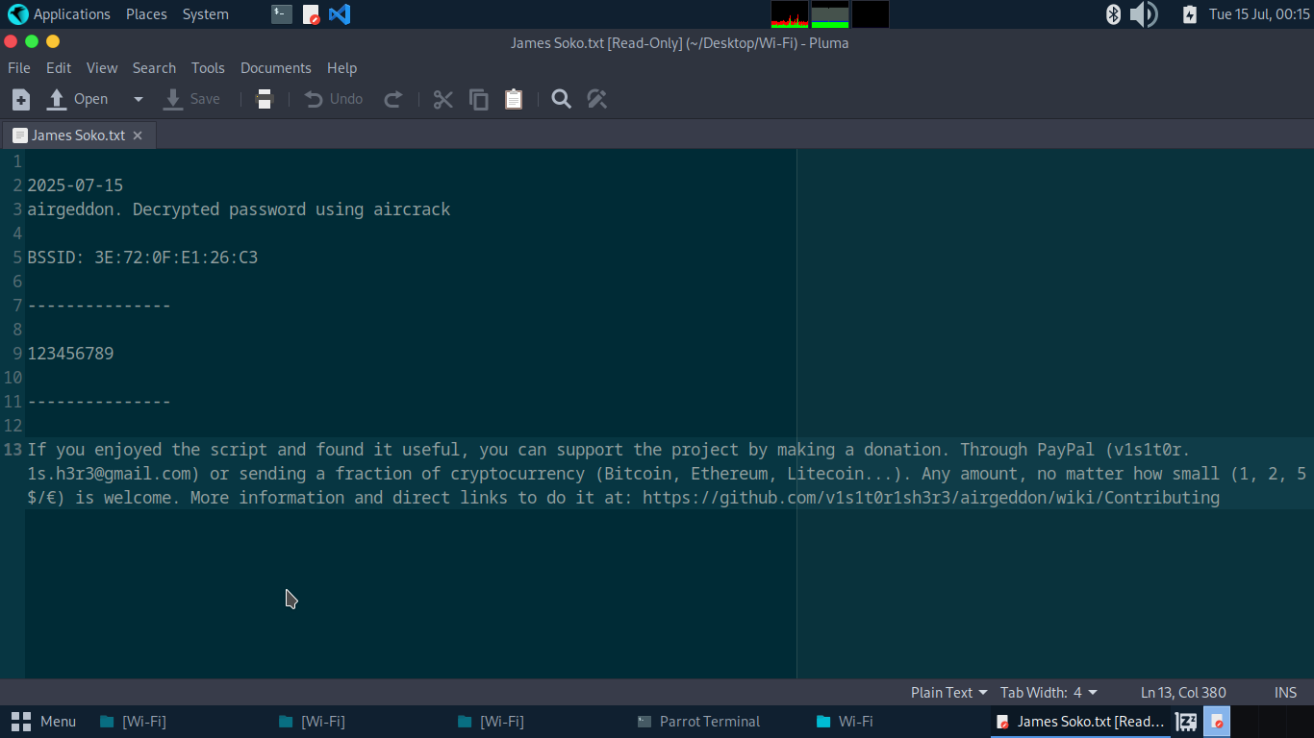
Wi-Fi Password Cracking
Will utilize rockyou wordlist by unzipping it (drag it to the Desktop and unzip it) because it is the biggest wordlist in Linux (139.9MBs) and there is a possibility we can crack the Wi-Fi (James Soko) password.

